Slide 1
ALL IN ONE E-SERVICES
CREATED BY:
S.MAHESUWARAN
S.JAYASURYA
S.LALKRISHNAN
SUPERVISED BY:
Mr. S.PRABHU M.Tech,
ASSISTANT PROFESSOR,
DEPARTMENT OF CSE,
PAAVAI COLLEGE OF ENGINEERING.

Slide 2
CONTENTS
Abstract
Introduction
Login Page
Framing
Hyperlink
Css
Conclusion
Reference

Slide 3
ABSTRACT
In this project we have try to give the best experience for the users.
who wants to use the correct government website
The best features of this website is having reference video.
It is very helpful for the person who don't know about the website or how to use it.
In this Project we want achieve great accuracy at minimum computational requirements.
It gives the main information about the documents needed for the particular information.

Slide 4
LOGIN PAGE
A login page is a web page or an entry page to a website that requires user identification and authentication, regularly performed by entering a username and password combination.
Logins may provide access to an entire site or part of a website.
Logging in not only provides site access for the user, but also allows the website to track user actions and behavior.
Logging off a webpage or site may be manual by the user or they can occur automatically when certain conditions (such as closing the page, turning off the computer, a long time delay, etc.) occur.

Slide 5
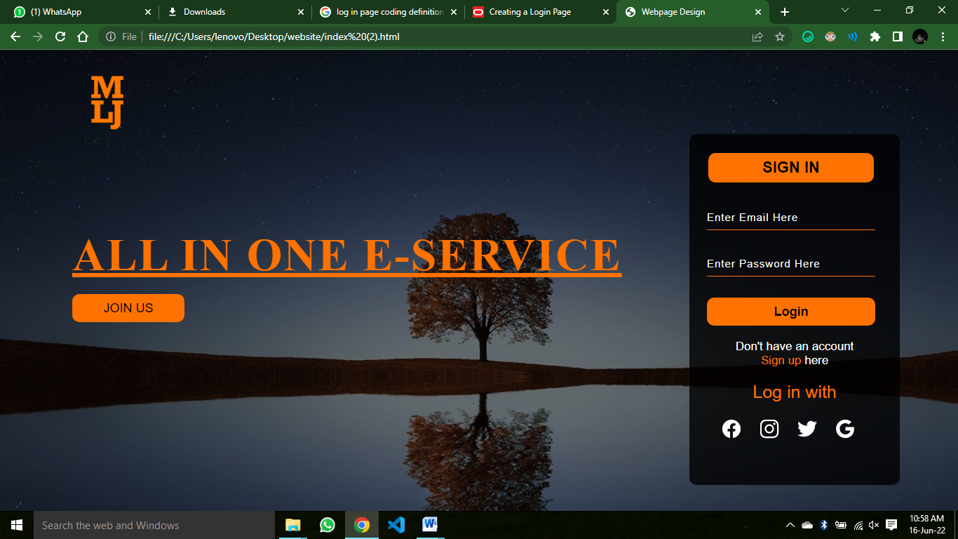
EXAMPLE

Slide 6
FRAMING
HTML frames are used to divideNext Page your browser window into multiple sections where each section can load a separate HTMLdocument.
A collection of frames in the browser window is known as a frameset.
The window is divided into frames in a similarway the tables are organized: into rows and columns.

Slide 7
DISADVANTAGES
There are few drawbacks with using frames,
So it's never recommended to use frames in your webpages -Some smaller devices cannot cope with frames often
Because their screen is not big enough to be divided up.
Sometimes your page will be displayed differently on different computers due to different screen resolution.
The browser's back button might not work as the user hopes.
There are still few browsers that do not support frame technology.

Slide 8
CREATING FRAMES
To use frames on a page we use <frameset> tag instead of <body> tag.
The <frameset> tag defines, how to divide the window into frames.
The rows attribute of <frameset> tag defines horizontal frames and cols attribute defines vertical frames.
Each frame is indicated by <frame> tag and it defines which HTML document shall open into the frame

Slide 9
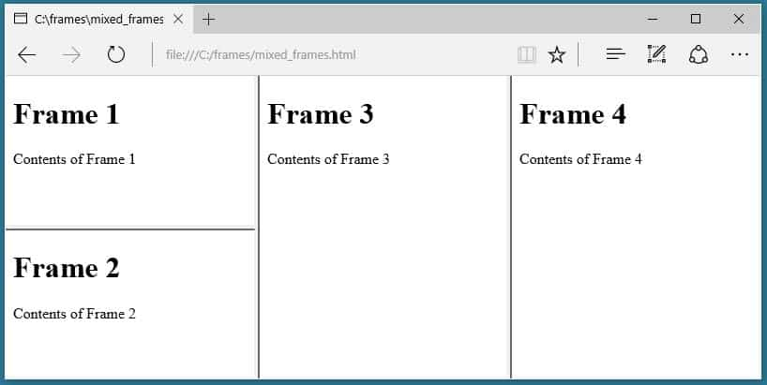
EXAMPLE

Slide 10
HYPERLINK
With HTML, easily add hyperlinks to any HTML page.
Link team page, about page, or even a test by creating it a hyperlink.
You can also create a hyperlink for an external website.
To make a hyperlink in an HTML page, use the <a> and </a> tags, which are the tags used to define the links.
The <a> tag indicates where the hyperlink starts and the </a> tag indicates where it ends.
Add the URL for the link in the <a href=” ”>.

Slide 11
EXAMPLE
<!DOCTYPE html>
<html>
<head>
<title>HTML Hyperlinks</title>
</head>
<body>
<h1>Company</h1>
<p>
We are a <a href="/about/about_team.htm">team</a> of professionals working
hard to provide free learning content.
</p>
</body>
</html>

Slide 12
CSS
CSS stands for Cascading Style Sheets.
CSS saves a lot of work.
It can control the layout of multiple web pages all at once.
Cascading Style Sheets (CSS) is used to format the layout of a webpage.
With CSS, you can control the color, font, the size of text, the spacing between elements, how elements are positioned and laid out, what background images or background colors are to be used, different displays for different devices and screen sizes, and much more!

Slide 13
TYPES
CSS can be added to HTML documents in 3 ways:
Inline - by using the style attribute inside HTML elements
Internal - by using a <style> element in the <head> section
External - by using a <link> element to link to an external CSS file

Slide 14
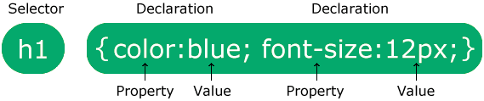
ARCHITECTURE

Slide 15
CONCLUSION
The conclusion of the my web should be make the usage government webs in easy form
The main concept is to avoid the unwanted or some other fake websites

Slide 16
REFERANCE
PRAROZ
W3SCHOOLS
INTERNET PROGRAMMING
GOVERNMENT WEBSITES
HTML LANGUAGE
CSS LANGUAGE

